Slide 1
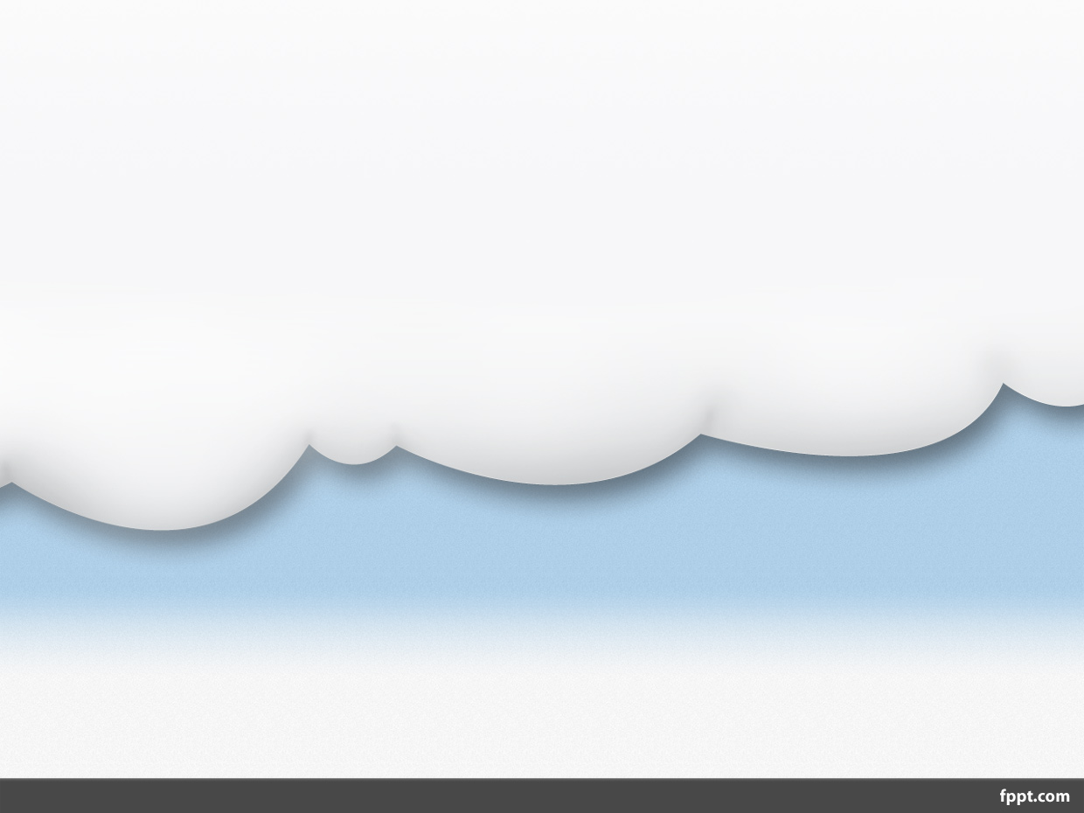
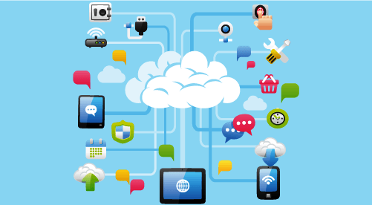
Cloud Architecture
(Desktop to Datacenter)

Slide 2
Architecture
Cloud Computing architecture comprises of many cloud components, which are loosely coupled. We can broadly divide the cloud architecture into two parts:
Front End
Back End
Each of the ends is connected through a network, usually Internet.

Slide 3
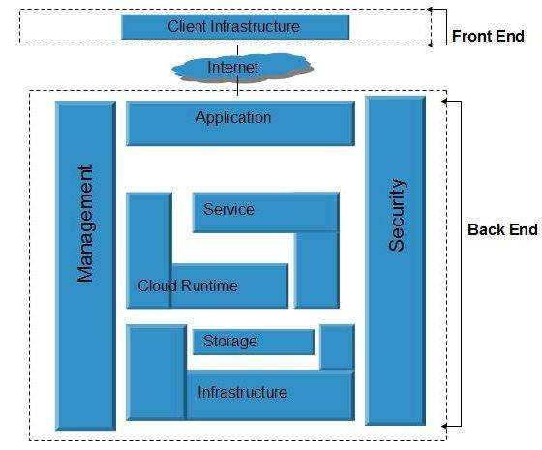

Slide 4
Front End
The front end refers to the client part of cloud computing system.
It consists of
Interfaces &
Applications
That are required to access the cloud computing
platforms,
Example - Web Browser.

Slide 5
Back End
The back End refers to the cloud itself. It consists of all the resources required to provide cloud computing services. It comprises of
  Huge data storage,
  Virtual machines,
  Security mechanism,
  Services,
  Deployment models,
  Servers, etc.
It is the responsibility of the back end to provide built-in security mechanism, traffic control and protocols.
The server employs certain protocols known as middleware, which help the connected devices to communicate with each other.

Slide 6
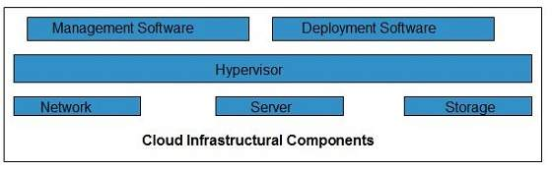
Cloud infrastructure

Slide 7
Hypervisor
Hypervisor is a firmware or low-level program that acts as a Virtual Machine Manager. It allows to share the single physical instance of cloud resources between several tenants.
Management Software
It helps to maintain and configure the infrastructure.
Deployment Software
It helps to deploy and integrate the application on the cloud.
Network
It is the key component of cloud infrastructure. It allows to connect cloud services over the Internet. It is also possible to deliver network as a utility over the Internet, which means, the customer can customize the network route and protocol.
Server
The server helps to compute the resource sharing and offers other services such as resource allocation and de-allocation, monitoring the resources, providing security etc.
Storage
Cloud keeps multiple replicas of storage. If one of the storage resources fails, then it can be extracted from another one, which makes cloud computing more reliable.

Slide 8
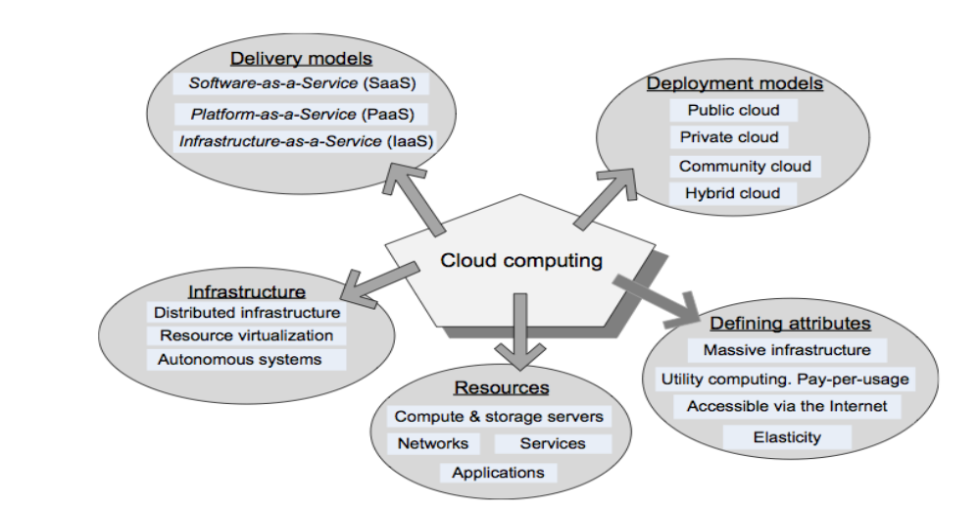
Different Entities of Cloud
Cloud is a large and complex system with many parameters, the understanding of which demands knowledge from various perspectives. Let us start by looking at the various parameters that need to be considered to understand the massive system called cloud. Although according to NIST cloud consists of five attributes, four deployment models and three delivery models, some researchers consider two more parameters to fully realize the complexity of cloud, viz., the infrastructure needed by cloud and the resources utilized therein.

Slide 9
Cloud Resources
Resources form the backbone of the cloud system. Typical cloud resources are:
  Compute servers, where all the computations take place.
  Storage servers, where all the data are stored.
  Networks, without which data centers cannot be connected and also users cannot access these data centers.
  Services, due to which cloud is called as utility computing.
  Applications, running of which is the backbone of Software as a Service or SaaS and also Platform.
The compute, storage and network hardware that power all cloud services and applications
ultimately must reside in a facility, connected by the network for accessibility, called a data center.

Slide 10
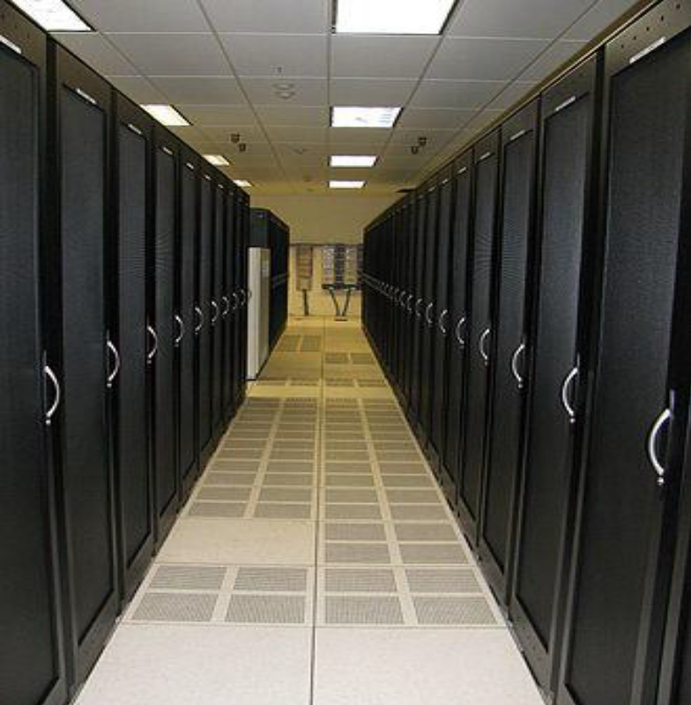
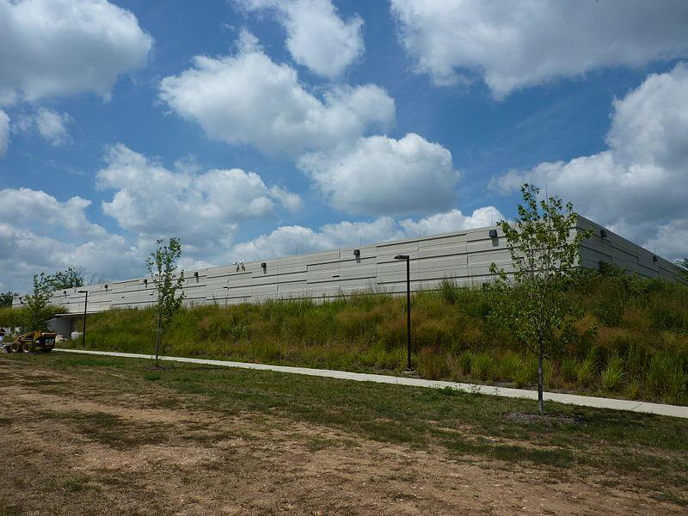
Data Centers
A data center is such a facility that is used to house computer systems and associated components, such as telecommunications and storage systems. Typically, it includes redundant or backup power supplies, redundant data communications connections, environmental controls (e.g., air conditioning, fire suppression) and various security devices..

Slide 11
Data Center
A data center may be as large as a shopping mall (11 times the size of a football field) under one roof, which can house 400,000 to 1 million servers. The larger the data center, the lower is the operational cost and hence there is obvious reason to build larger data centers.
Perhaps the largest problem about running a data center successfully is two power related issues: power supply and power consumption. Computers and networks necessarily need power to operate but, no matter how reliable electric grid one may use, there would always be the possibility of power outage. To avoid problems such as data loss, quality data centers will have to be equipped with UPS and generators.
The other side of this issue is the excessive power consumption by data centers and hence the carbon emission problem of such large facilities.
Another factor of data centers is the cost. It is expensive to build and maintain a data center. Network and datacenter cloud services represent significant capital investments. While expensive and power consuming, data centers are the nerve center for cloud services and utilizing datacenter services, the next layer of the cloud stack provides compute and storage cloud services.

Slide 12
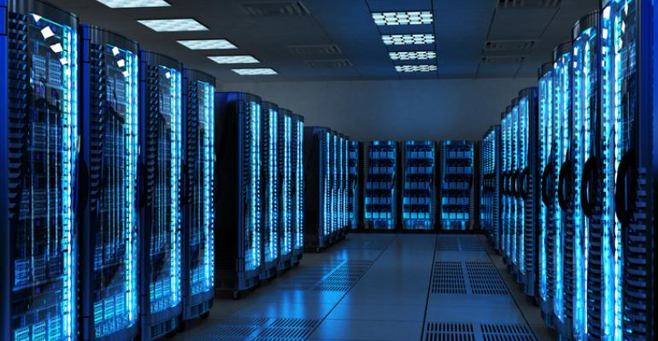
Data Center
Private cloud itself is considered as a Data Center.
In public cloud a big data center can be shared by many us stored.
According to A.K.Soman (2010) “A Data center is a facility that houses infrastructure for secure storage and processing of Data and accessible over the internet”. Cloud service provider’s infrastructure is usually housed in a Data center. The security of cloud depends on its Datacenter. Modern

